Slide 1
Program Name goes here
Link to github Repository:
https://github.com/21308/CSC2
Links to trell o board / project management tools: https://trello.com/b/s7tssMlB/minimoviefundraiser
You MUST provide evidence showing how the problem has been decomposed, how the components have been developed and trialled, and of how they have been assembled and tested to create a final, working outcome.

Slide 2
Relevant Implications
Explain the relevant implications here. Please watch this video to learn how to do this.
Notes:
Explain the relevant implications here. Then as you work, develop your code, discuss how the implications are being met.

Slide 3
Relevant Implications – Functionality
Functionality involves ensuring that the program works as expected. It should work for expected, boundary and unexpected cases. For example, my program asks how many rounds a user wants. It needs to work for a ‘sensible’ answer like 2 and it should also accept 1 (low valid) and it should not crash if users put in 0 (too low), text or a decimal.
Functionality matters because if a program does crashes or gives incorrect output users will become frustrated. Programs that don’t work correctly are of limited use and in real life, if a program does not function it could cause harm and / or damage the reputation of the developer.
Notes:
Explain the relevant implications here. Then as you work, develop your code, discuss how the implications are being met.

Slide 4
Relevant Implications – Usability
Usability is about how easily the end user can accomplish tasks. It deals with issues like making instructions and error messages clear and easy for the users to understand.
Usability matters because if a program is hard to use people will get frustrated and give up. This could result in the program not being used / bought (and the developer would loose money).
Notes:
Explain the relevant implications here. Then as you work, develop your code, discuss how the implications are being met.

Slide 5
Relevant Implications - Aesthetics
Aesthetics involves an outcome’s overall appearance. A program which has well spaced instructions, prompts and ‘decoration’ around key messages is more aesthetically pleasing that a program composed of unspaced, plain text.
Aesthetics matters because users prefer interfaces which are attractive over those that are plain / boring.
Notes:
Explain the relevant implications here. Then as you work, develop your code, discuss how the implications are being met.

Slide 6
Relevant Implications - Social
The specifics of a social implication depend on the outcome being developed! You will need to customize some of your explanation to take this into account.
The social implications of an outcome involve how it affects users, the wider community and society as a whole. For example, gambling games can have a negative effect on society if there are no safeguards in place to limit users from excessive losses.
The social implications matter because if they are not considered and addresses, an outcome could have unintended consequences.
Notes:
Explain the relevant implications here. Then as you work, develop your code, discuss how the implications are being met.

Slide 7
Decomposition
Paste screenshots of your initial Trello board / task decomposition on this slide. If you have a long list, you might need to break it up into several columns. Delete this instruction when you are done.
Notes:
Paste screenshots of your initial Trello board / task decomposition on this slide. If you have a long list, you might need to break it up into several columns. Delete this instruction when you are done.

Slide 8
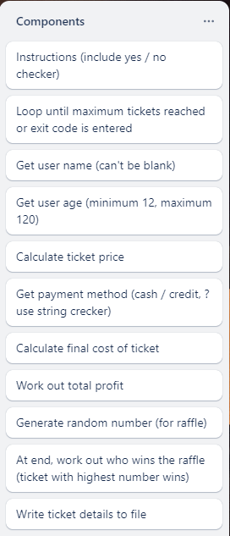
Component 1 (Trello screenshot)
Here is my initial decomposition.
Things will almost certainly change / be adjusted as the outcome is developed.

Slide 9
Component 1 - Test Plan (?and screenshot)
Test Case | Expected Values

Slide 10
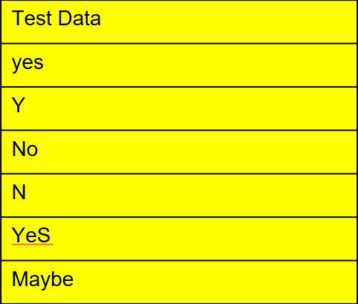
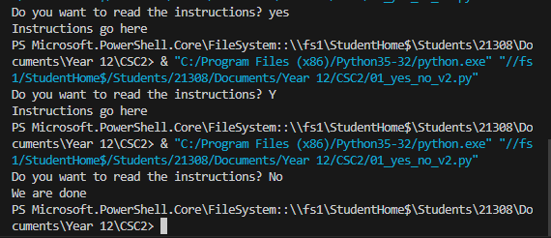
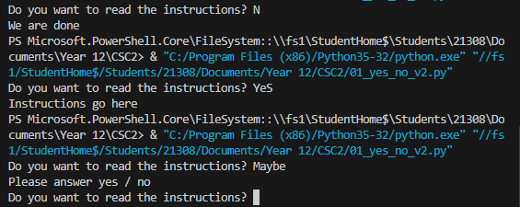
Component 1 - Test Plan (?and screenshot)
Test Case | Expected Values
I tested all these test data to get the expected outcome. | When I tested the test data it printed what it should of to represent the answer.

Slide 11
Yes/no checker
To check that see_instructions is a Yes / No response
Test Data | Expected
yes | program continues
Y | program continues
No | program continues
N | program continues
YeS | program continues
Maybe | Please enter either “Yes” or “No”.

Slide 12
Looping Component
Maximum number of tickets set to 3 of testing purposes.
Test Case | Expected Value
Enter a name: a Enter a name: b Enter a name: c | <program loops> <program loops> <program loops> Congratulations, you have sold all the available tickets.
Enter a name: a Enter a name: b Enter a name: xxx | <program loops> <program loops> You have sold 2 ticket/s. There is 1 ticket/s remaining.

Slide 13
Instructions Component
Test Case | Expected Values
Do you want to see the instructions? Maybe Do you want to see the instructions? Yes | <error, please enter yes/no> Display Instructions
Do you want to see the instructions? No | <program continues>

Slide 14
Check username is not blank
Test Case | Expected Value
Enter your name (or ‘xxx’ to quit) Enter your name (or ‘xxx’ to quit): a Enter your name (or ‘xxx’ to quit): xxx | Please enter a name, this can’t be blank <program continues> “We are done”

Slide 15

Check username is not blank
Test Case | Expected Value
Enter your name (or ‘xxx’ to quit) Enter your name (or ‘xxx’ to quit): a Enter your name (or ‘xxx’ to quit): xxx | Please enter a name, this can’t be blank <program continues> “We are done”

Slide 16
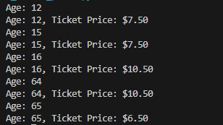
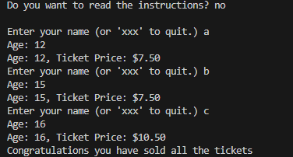
Check ticket price
Test Case | Expected Value
Age: 12 | Please enter a age <program continues> “(Age: 12, Ticket Price: $7.50)”

Slide 17
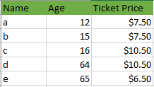
Ticket Price Calculator

Slide 18
Get Payment Method (Cash / Credit)
Test Case | Expected Values
Cash | You have chosen to pay with cash
CA | You have chosen to pay with cash
Credit | You have chosen to pay with a credit card
cr | You have chosen to pay with a credit card
tokens | Sorry, that is not a valid payment method, please choose cash (ca) or credit (cr)

Slide 19
String Checker Trialing
V1: Uses a function similar to the yes / no checker
V2: Realized that we can use the SAME function for both our yes / no and out cash / credit checker. This function takes in a list of acceptable values and checks that the user types in a…
One of the items in the list
The first letter (for yes / no)
The first two letters (cash / credit)
This checker would not work if some of the items in our list had a short form of the first letter for some items and two letters for other items <eg: image (im), integer (in), text (t)>

Slide 20
String Checker Trialing (refinement)
V3: The function includes a customized error messaged based on the list of acceptable responses. This took a fair bit of trialing to implement.
For this project, I’ll use version 3 as we have a single function that can be used to check two different strings. The customized error helps us address the usability implication.

Slide 21
Version Control Evidence
Your version control evidence should go here. This could be in the form of annotated screenshots which show you you managed this process or you could make a brief screencast explaining how you implemented version control.
Notes:
Your version control evidence should go here. This could be in the form of annotated screenshots which show you you managed this process or you could make a brief screencast explaining how you implemented version control.

Slide 22
Discusses how the information from planning, testing and trialling of components assisted in the development of a high-quality outcome
Notes:
Discusses how the information from planning, testing and trialling of components assisted in the development of a high-quality outcome

